Slide 1
Weill Cornell
Locator Map
by:
Jessica & Pat

Slide 2





Where
is this
Photo place?
Am I
Close…
A126
A162..?

Slide 3
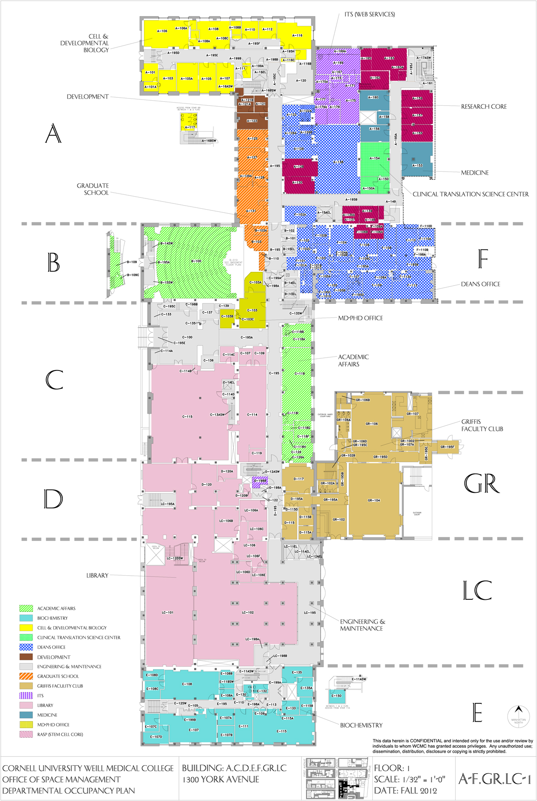
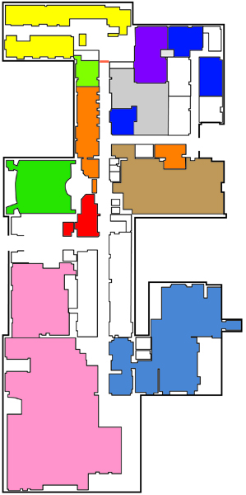
Am I
Close…
A126
Step 1: Floor Plans
Space Management emailed the floor plans for 1300
Levels: Basement, Floor 1 & Floor 2 were selected
Plans were redrawn using Illustrator

Slide 4
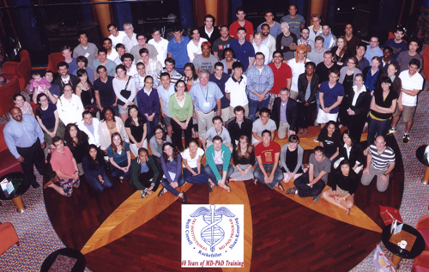
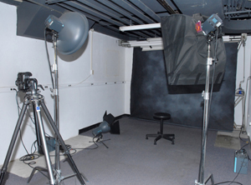
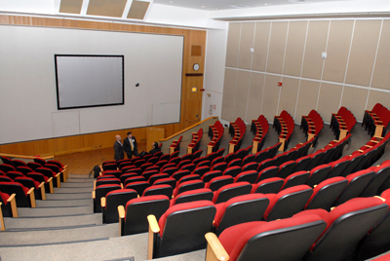
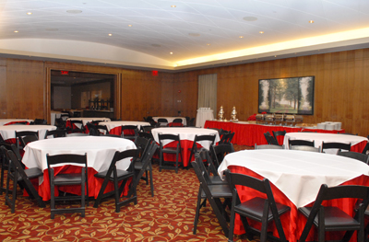
Am I
Close…
A126
Step 2: Collecting Photos
Most of the photos were shot during last month
Some were from photo archives
Some supplied by departments

Slide 5
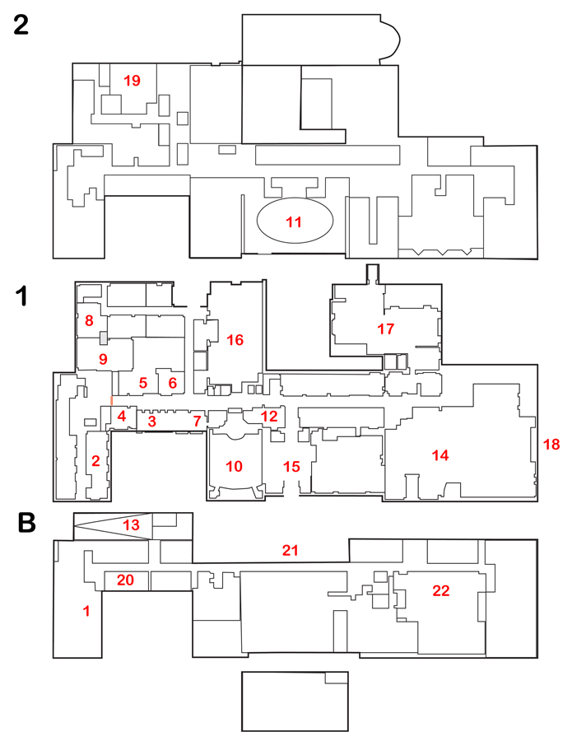
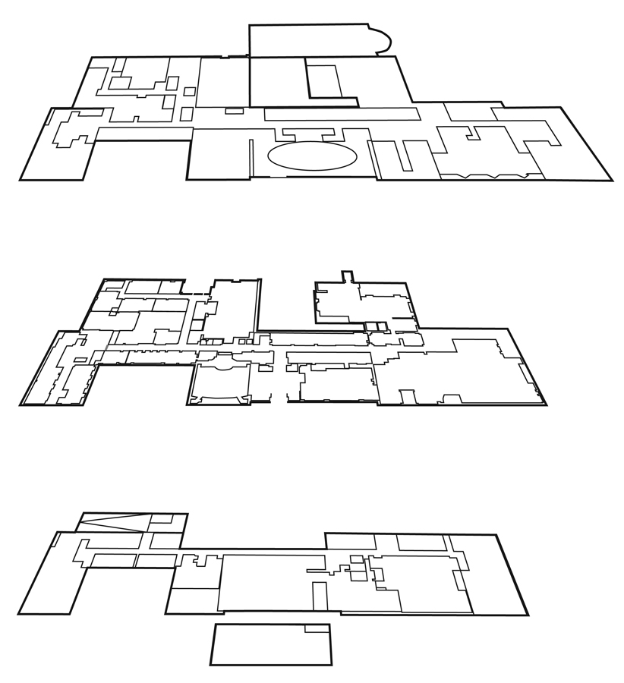
Am I
Close…
A126
Step 3: Final Preparation
Photo list & diagram sent to Jessica
Jessica suggested skewing of floors
Jessica puts an excellent map together

